Slide 1

<<PROJECT TITLE **TIMES NEW ROMAN FONT SIZE 39**>>
M.Tech Project Work Final Review
Presented by
<<STUDENT NAME (STUDENT REGISTER NO)>>
<<M.Tech Computer Science and Engineering (SPECILAZATION)>>
Under the Guidance of
<<GUIDE NAME>>
<<GUIDE DESIGNATION>>
School of Computer Science and Engineering
Vellore Institute of Technology, Chennai.

Slide 2
CONTENTS
ABSTRACT
INTRODUCTION
LITERATURE SURVEY
RESEARCH GAPS
OBJECTIVES
MODULE IDENTIFICATION
SYSTEM ARCHITECTURE
DEVELOPMENT & INTEGRATION
PROTOTYPE / RESEARCH FRAMEWORK
OUTCOME
RESULTS
TIMELINE / GANTT CHART
REFERENCES

Slide 3
1.ABSTRACT
<< NOT MORE THAN 200 WORDS FONT TIMES NEW ROMAN SIZE 24>>
<< Brief summary of project including problem, methodology, and expected outcome >>

Slide 4
2. INTRODUCTION
<< Overview of problem domain, motivation, and objectives (max 150 words) FONT TIMES NEW ROMAN SIZE 24>>

Slide 5
3.LITERATURE SURVEY
S.No | Article Title | Techniques Used | Key Findings | Limitations
1
2
3
4

Slide 6
LITERATURE SURVEY (CONTD..,)
S.No | Article Title | Techniques Used | Key Findings | Limitations
5
6
7
8

Slide 7
LITERATURE SURVEY (CONTD..,)
S.No | Article Title | Techniques Used | Key Findings | Limitations
9
10

Slide 8
4. RESEARCH GAPS

Slide 9
5. OBJECTIVES

Slide 10
6. MODULE IDENTIFICATION
<< • Identify key modules/subsystems
• Define functionality of each module
• Show module interaction
FONT TIMES NEW ROMAN SIZE 24>>

Slide 11
7. SYSTEM ARCHITECTURE
<< • Overall architecture diagram
• Data flow between modules
• Technology stack used TEXT FONT TIMES NEW ROMAN>>

Slide 12
8. DEVELOPMENT & INTEGRATION
<< • Implementation of modules
• Integration strategy
• Challenges faced and solutions
FONT TIMES NEW ROMAN>>

Slide 13
9. PROTOTYPE / RESEARCH FRAMEWORK
<< • Working prototype description
OR
• Research framework setup
FONT TIMES NEW ROMAN>>

Slide 14
10. OUTCOME
<< • Working model screenshots/results
OR
• Data classification & analysis
• Key insights/results
FONT TIMES NEW ROMAN>>

Slide 15
11. RESULTS
<< • Performance metrics
• Observations
• Validation of approach
FONT TIMES NEW ROMAN>>

Slide 16
12. TIMELINE / GANTT CHART
• Planned vs completed tasks
• Next milestones

Slide 17
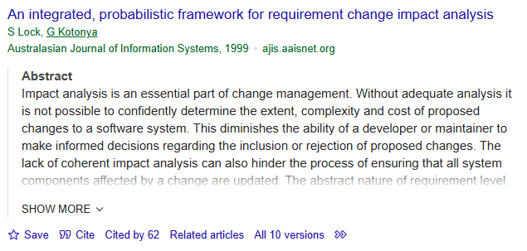
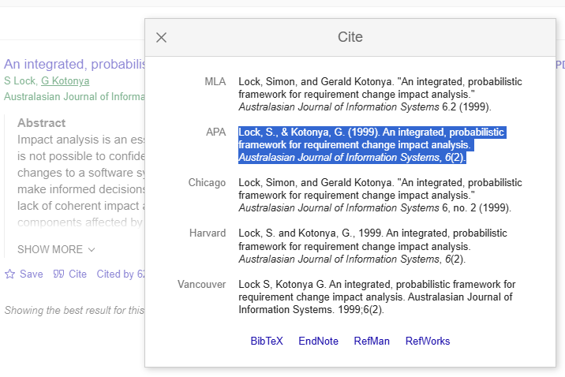
13. REFERENCES
Lock, S., & Kotonya, G. (1999). An integrated, probabilistic framework for requirement change impact analysis. Australasian Journal of Information Systems, 6(2).
HOW TO CITE A PAPER
GO TO GOOGLE SCHOLAR
GIVE THE PAPER TITLE IN SEARCH
ONCE THE PAPER WHAT YOU HAVE SEARCHED FOR IS LISTED
CHOOSE CITE AT THE BOTTOM OF THE PAPER
SELECT APA FORMAT AND COPY IT HERE

Slide 18
REFERENCES (CONTD..,)

Slide 19
REFERENCES (CONTD..,)

Slide 20
REFERENCES (CONTD..,)

Slide 21
REFERENCES (CONTD..,)

Slide 22
Thank You

